Slide 1
Budweiser Case Study
by Megan Riley and Edgar Nunez

Slide 2
Key Question: How many breweries are in each state?
Overall States such as California and Colorado dominate with 47 and 39 local breweries respectively. But many states have over 10 breweries statewide.
Focusing on one or two states would limit potential market share.

Slide 3
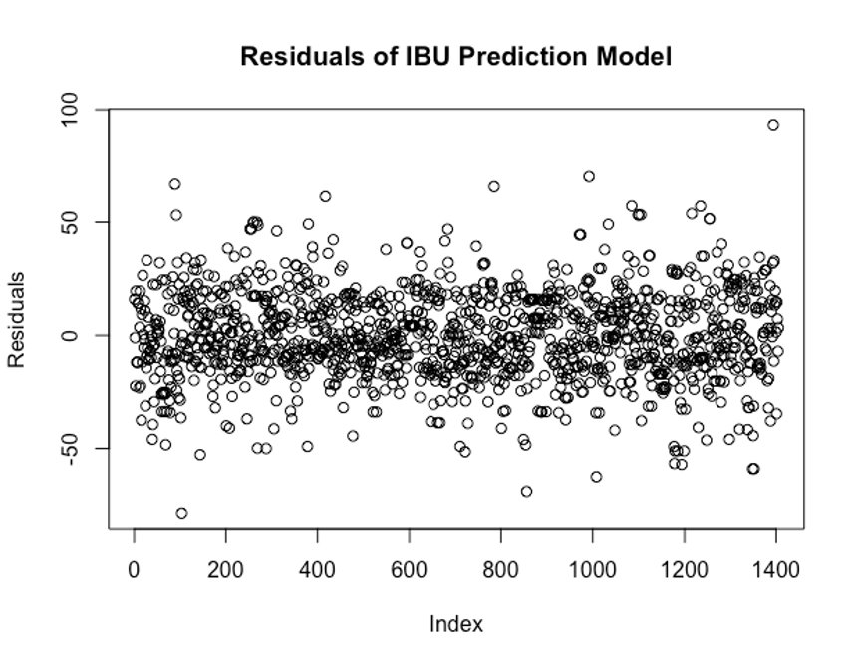
Key Question: Missing Data in the IBU Column
We ran an initial investigation to predict the IBU values based on the paired ABV values of the beer as 41% of IBU values were missing in the original data.
The model is not perfect and leaves a lot of variation unexplained. Without further information it is our best prediction

Slide 4
Key Question: Missing Data
After the data is imputed with a linear model the general shape of the IBU data values changes.
Furthermore by basing imputed IBU values on ABV values future analysis on the relationship between the two variables will be affected.
The 62 final missing values in IBU and ABV are imputed with the median and should not heavily change the distribution.

Slide 5
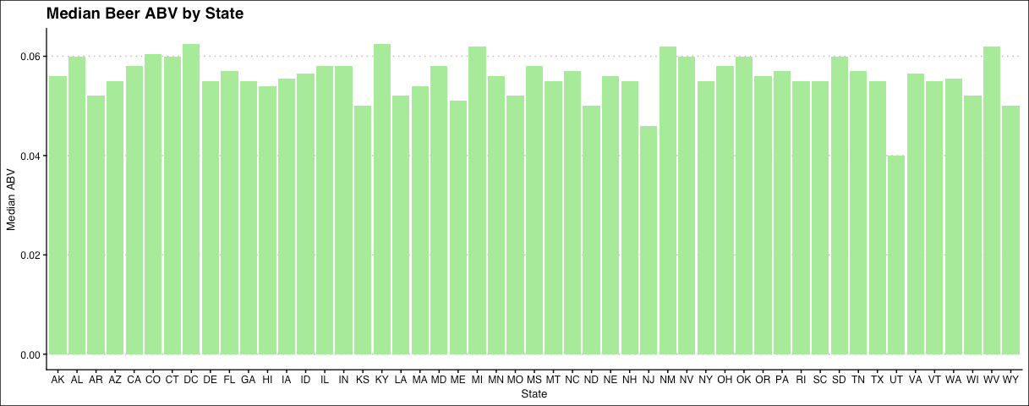
Key Question: What is the Median ABV by State?
Overall most states have similar Median ABV's.
Notably Utah's Median ABV is lower than most others.

Slide 6
Key Question: What is the Median IBU by State?
The first graphic represents the original distribution of Median IBU by state. This does not include missing values.
The second graphic includes imputed IBU values which changes the variance in IBU by State.
Maine seems to have diminished greatly in Median IBU

Slide 7
Key Question: Which State has the most alcoholic beer? Which has the most bitter?
Colorado brews the most alcoholic beer in our records with an ABV of .128
This is the Lee Hill Series Vol. 5, a Belgian Style Quadrupel Ale brewed by Upslope Brewing Company.
The most bitter beer in our records has a strong 138 IBU.
It is appropriately named Bitter Bitch Imperial IPA Brewed by Astoria Brewing Company in Oregon

Slide 8
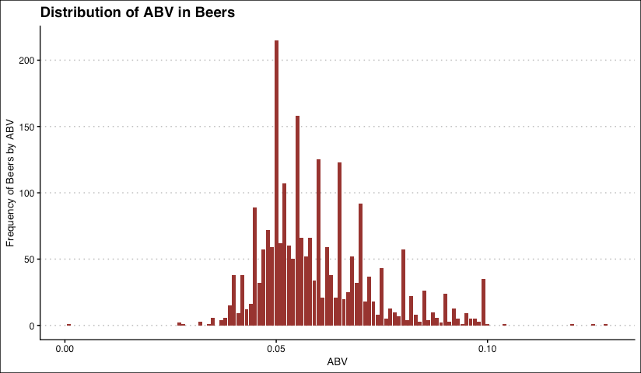
Key Question: Discussing the distribution of ABV in beers
Overall most of the beers fall within a .05 ABV and .10 ABV and it is a right skewed distribution
The minimum ABV value is .001 almost non-alcoholic.

Slide 9
Key Question: The relationship between IBU and ABV
The relationship between IBU and ABV is a positive linear correlation. However there is quite a lot of variance .
This variance is also diminished with the current data set including imputed values based on the very relationship at hand. Therefore the original data is graphed above the data including imputed values.

Slide 10
Key Question: Can we differentiate IPAs from Ales by IBU and ABV?
We determined the best route for this analysis is with a KNN(K- Nearest Neighbors) approach.
To the right are the separate graphs for IPAs and Ales. The different clusters can be seen.

Slide 11
Key Question: Can we differentiate IPAs from Ales by IBU and ABV?
We ran the KNN analysis with 80% of the data as a training set.
The resulting model correctly identifies between the two beers 81% of the time.
To the right we can see the true classification and see how the clusters overlap and may be influenced by the IBU imputation.

Slide 12
Key Question: Can we differentiate IPAs from Ales by IBU and ABV?
The resulting KNN model has a 81% accuracy with 89% specificity and 68% sensitivity.
To the right we can see the numbers of correctly and incorrectly predicted Ales and IPAs. Likely due to the variation in Ales they are more often predicted over IPAs.

Slide 13
Next Steps in Analysis
Accessing consumption rates in beer by state will give new insight into production data we have and business opportunities where production may be lacking.
To the right we can see per capita consumption in thousands of gallons per state.
Some of the northernmost states are heavy consumers.

Slide 14
Average Per Capita Consumption of Alcohol in Beer
Per Capita consumption of beer is only part of the consumption story. By combining average ABV per state with our per capita beer consumption we can see the actual average alcohol consumption per state.
Nevada stands out more here than previously as it has a higher average ABV.

Slide 15
Producing and Consuming States
Finally we can combine the actual number of beers produced by state with per capita consumption of beers.
This resulting statistic gives us an indication of which states are lacking in locally produced beers.
The lighter states are consumers without local production, the darker states have higher production for the amount of beer they drink.

Slide 16
Thank You

